Slide 1
Business Model
Value proposition:
PACKAGING AND DISPLAY
AFFORDABLE PRICING
Target market:
Farmers and customers.
Competitive advantage: To improve production analysis.

Slide 2
Business Model Cont
Cost structure:
machinery
packaging material
workers payments
Key metrics:
PERCENTAGE YIELD
Sustainability: small holder farmers inclusion in the markets

Slide 3
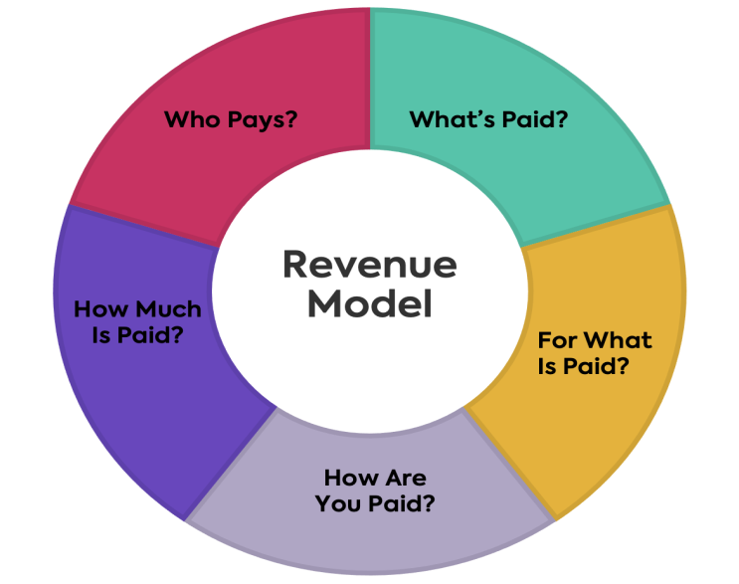
Revenue Model
Who pays? | What’s paid? | For what is paid? | How are you paid? | How much is paid?
Farmers | Money | Work done by workers | Monthly | Depends on the number of hours worked. E.g P15 /per hr

Slide 4
FEASIBILITY STUDY

